Slide 1
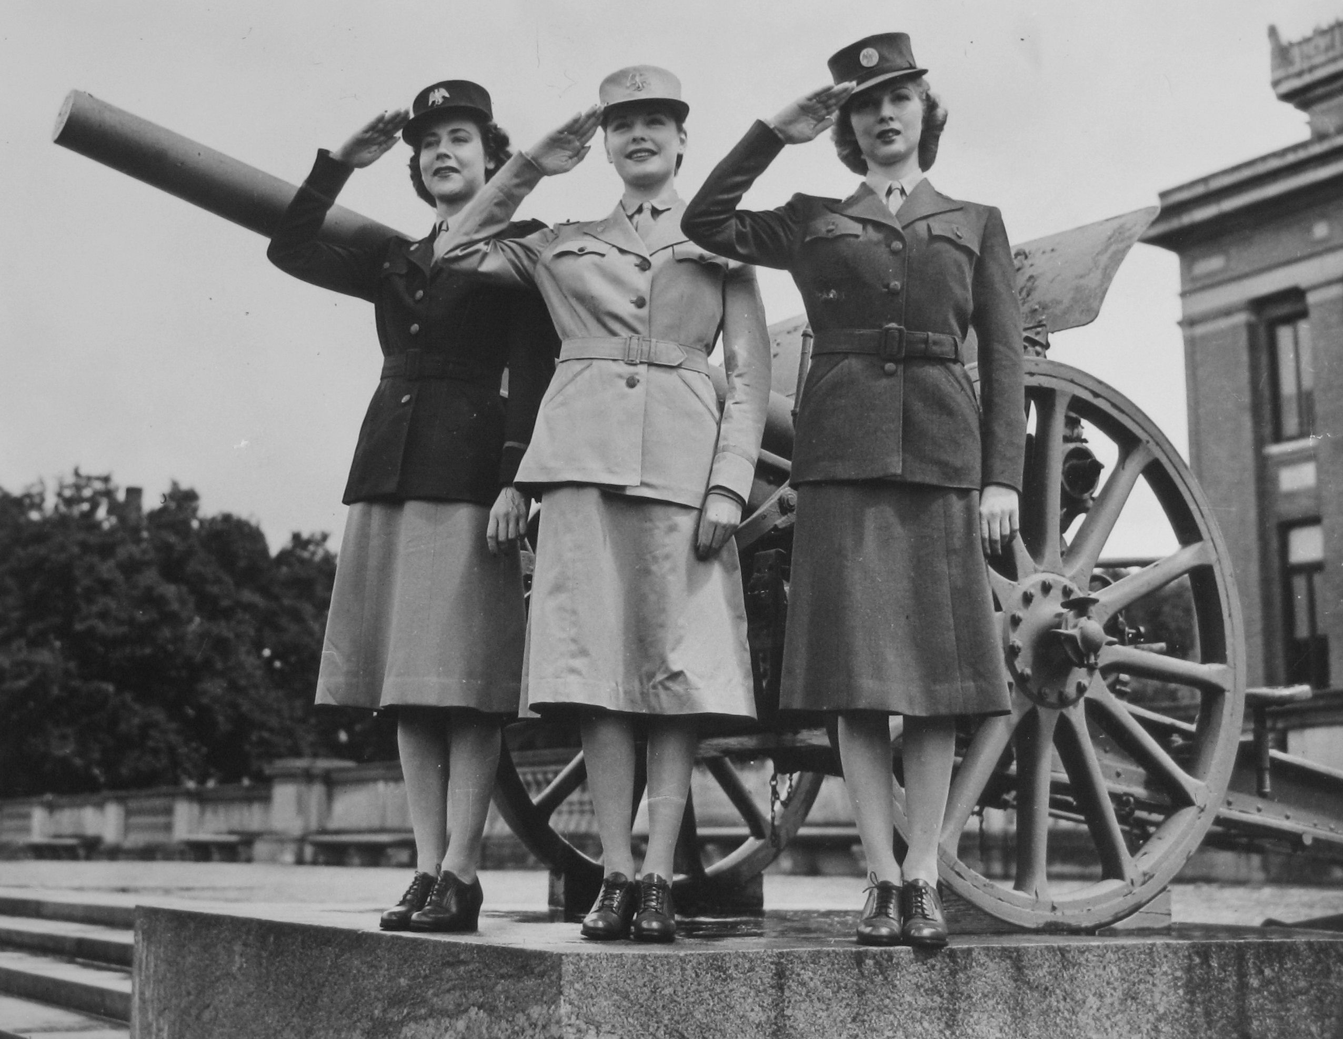
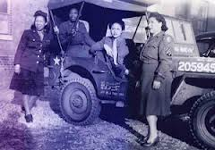
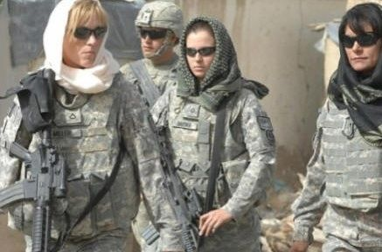
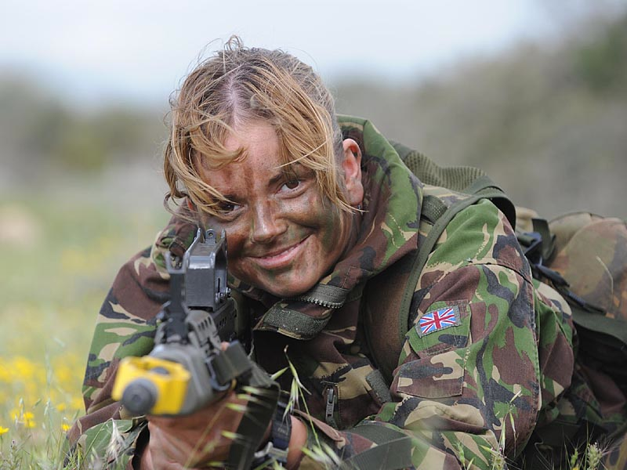
Women in the Military
Week Three

Slide 2
Women Have Served in Every American war
They served as nurses, cooks, even spies.
Some even dressed the part of soldiers and fought:
- Deborah Sampson as Robert Shurlief in the Rev. War
- Sarah Wakeman as Lyons Wakeman in the Civil War
- Elizabeth Newcom as Bill Newcom in the Mexican War
Dr. Mary Walker, Civil War physician was taken prisoner and is still the only woman to receive the National Medal of Honor.

Slide 3
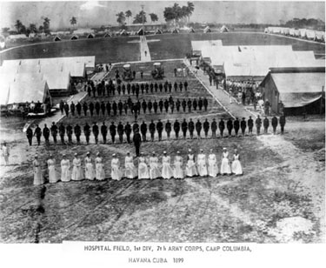
1500 women volunteered in the Spanish American War (1898)
1901 Army Nurse Corps established
1908 Navy Nurse Corps established

Slide 4
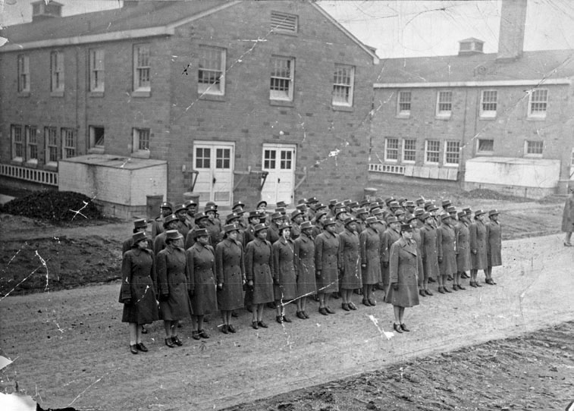

36,000 in World War I (1917-1918)
(400 of these die in line of duty)

Slide 5
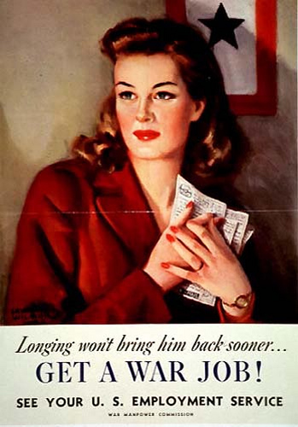
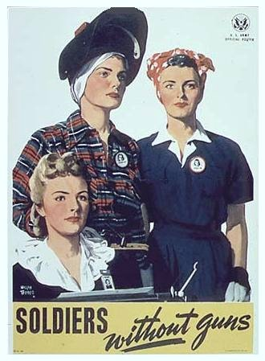
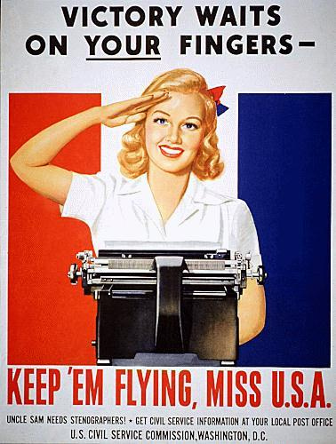
The Government Organizes a Massive Effort to Attract Women into the Workforce.

Slide 6
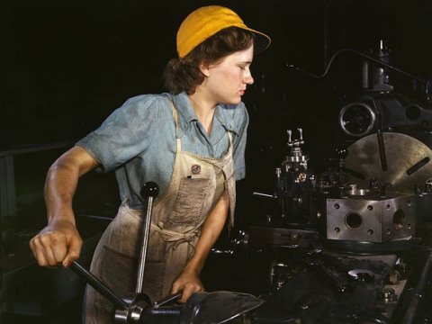
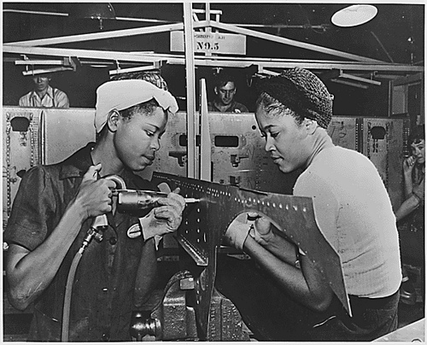
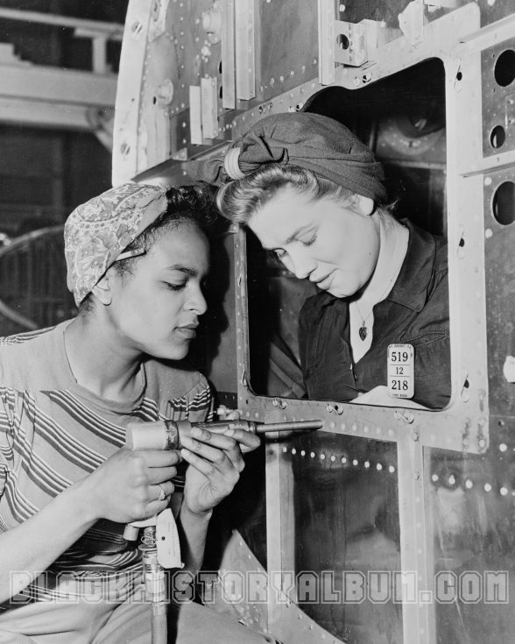
Women Flocked to the Factories producing the planes, jeeps, and bombs for the war

Slide 7
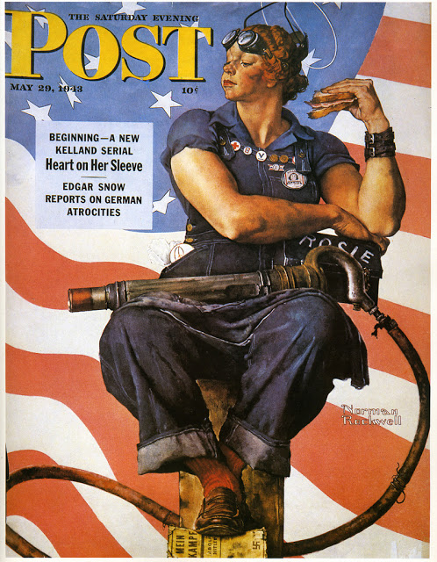
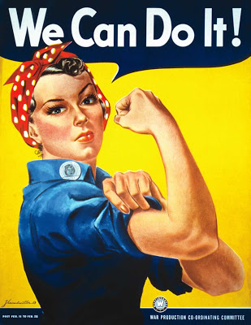
J. Howard Miller of Westinghouse
Norman Rockwell, May 29, 1943

Slide 8

Rosie the Riveter song, precursor to Rockwell’s Image

Slide 9
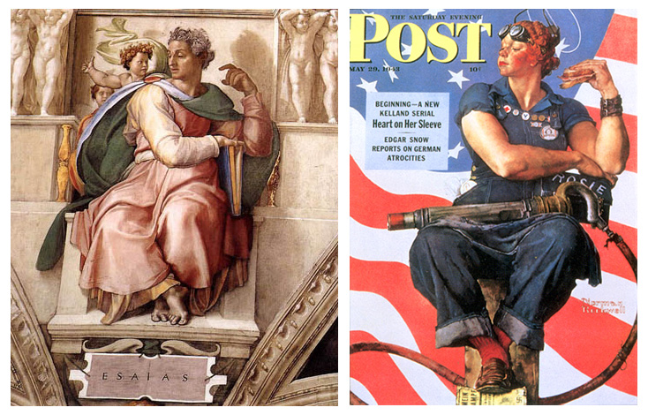
Michelangelo’s Isaiah
Rockwell’s Rosie
For more on this, see Sheridan Harvey’s research (http://www.loc.gov/rr/program/journey/rosie.html

Slide 10

Ford Motor Company Recruitment Film, 1943

Slide 11
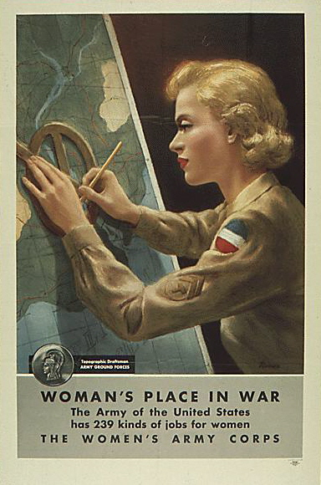
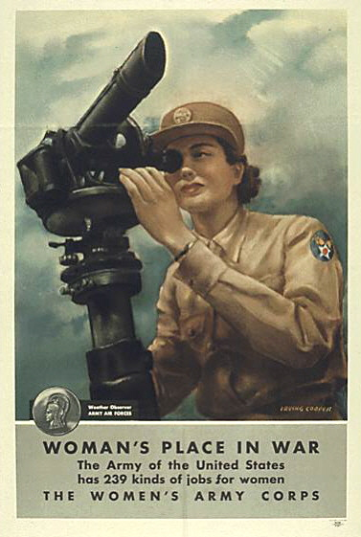
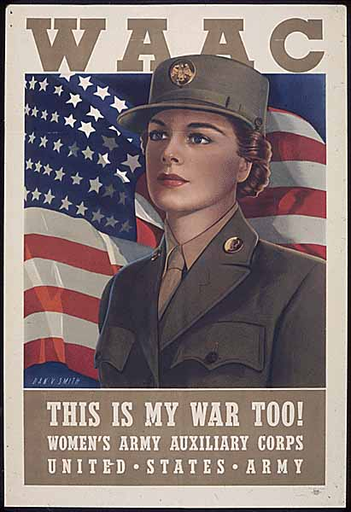
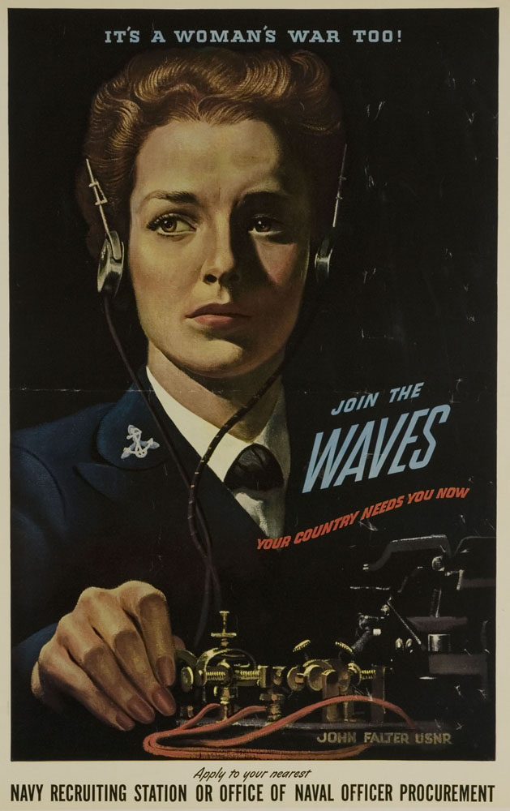
400,000 women enlist in the WACs, WAVES, SPARs, & the Marine Corps Women’s Reserve

Slide 12

As women showed that they could excel in jobs they had never before done, their counterparts who enlisted showed their expertise as well and “free a man to fight”

Slide 13
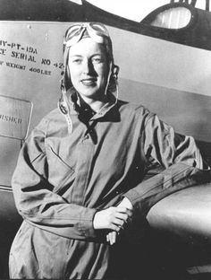
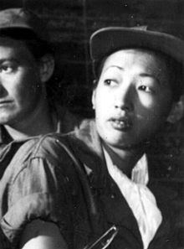
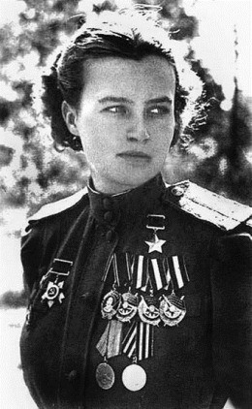
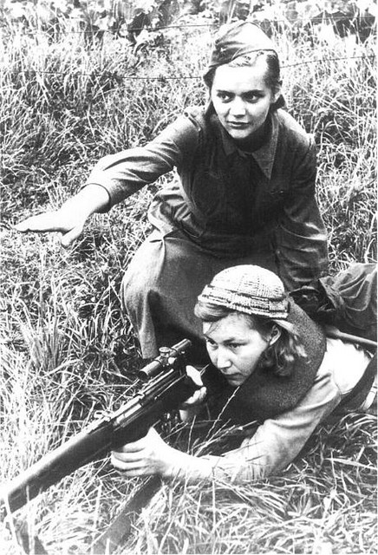
Women Air Force Service Pilots (WASPs)
Hazel Ying Lee flew new, untested planes, including combat planes.
Natalya Meklin, Russian WWII pilot who flew 980 combat missions. Member of the “Night Witches,” 3 regiments of women pilots who flew 24,000 combat missions
Cornelia Foot, WASP, first female aviator to die while on active duty

Slide 14
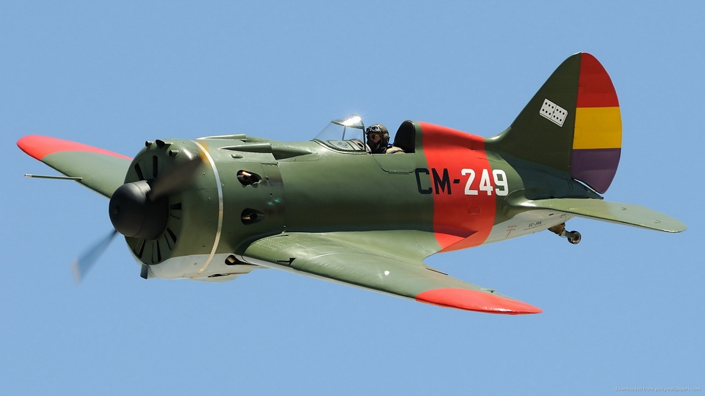
The “Polikarpov” Planes were flown by Russia’s “Night Witches”
At the end of WWII, the Russian female pilots were told not to speak about their achievements.

Slide 15
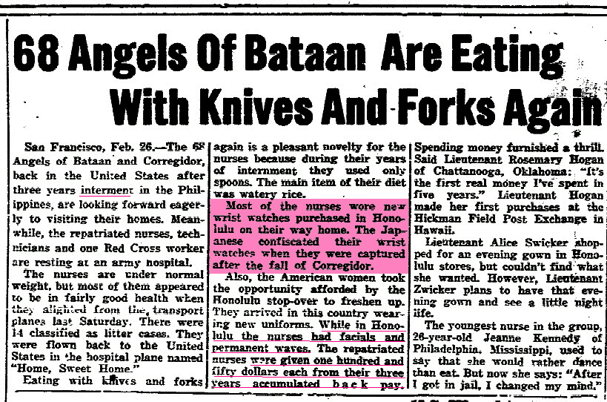
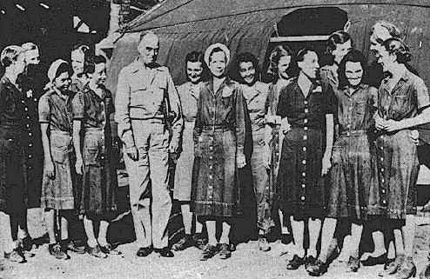
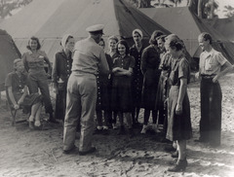
WWII Women were taken prisoners: 68 Army nurses in the Philippines, 5 Navy nurses in Guam, 11 Navy nurses in the Philippines

Slide 16
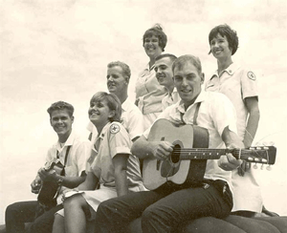
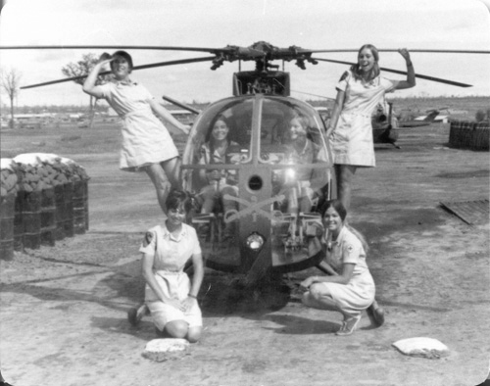
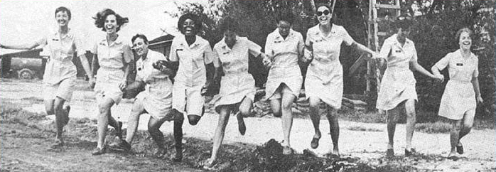
50,000 women volunteered during the Korean War (1000 deployed; the rest in support positions stateside)
265,000 during the Vietnam war (7500 were deployed)
As in WWI and WWII, civilian Red Cross and USO workers, called “Donut Dollies” also went to war.

Slide 17
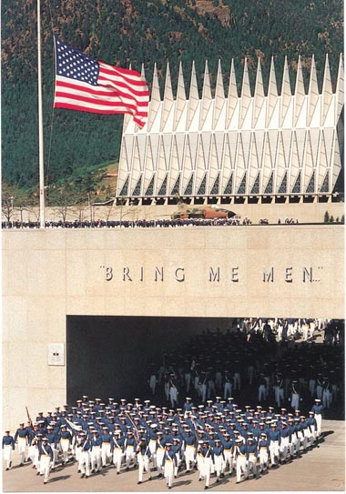
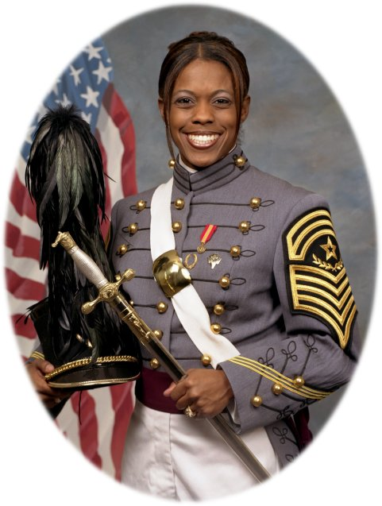
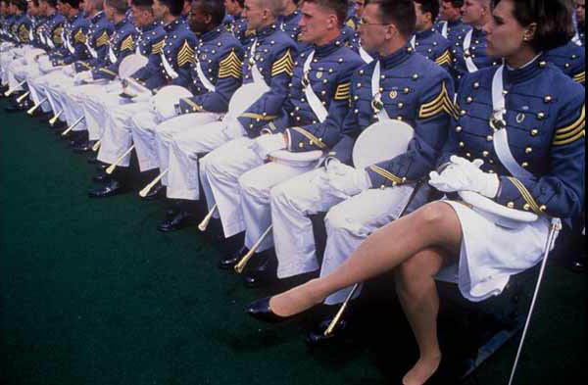
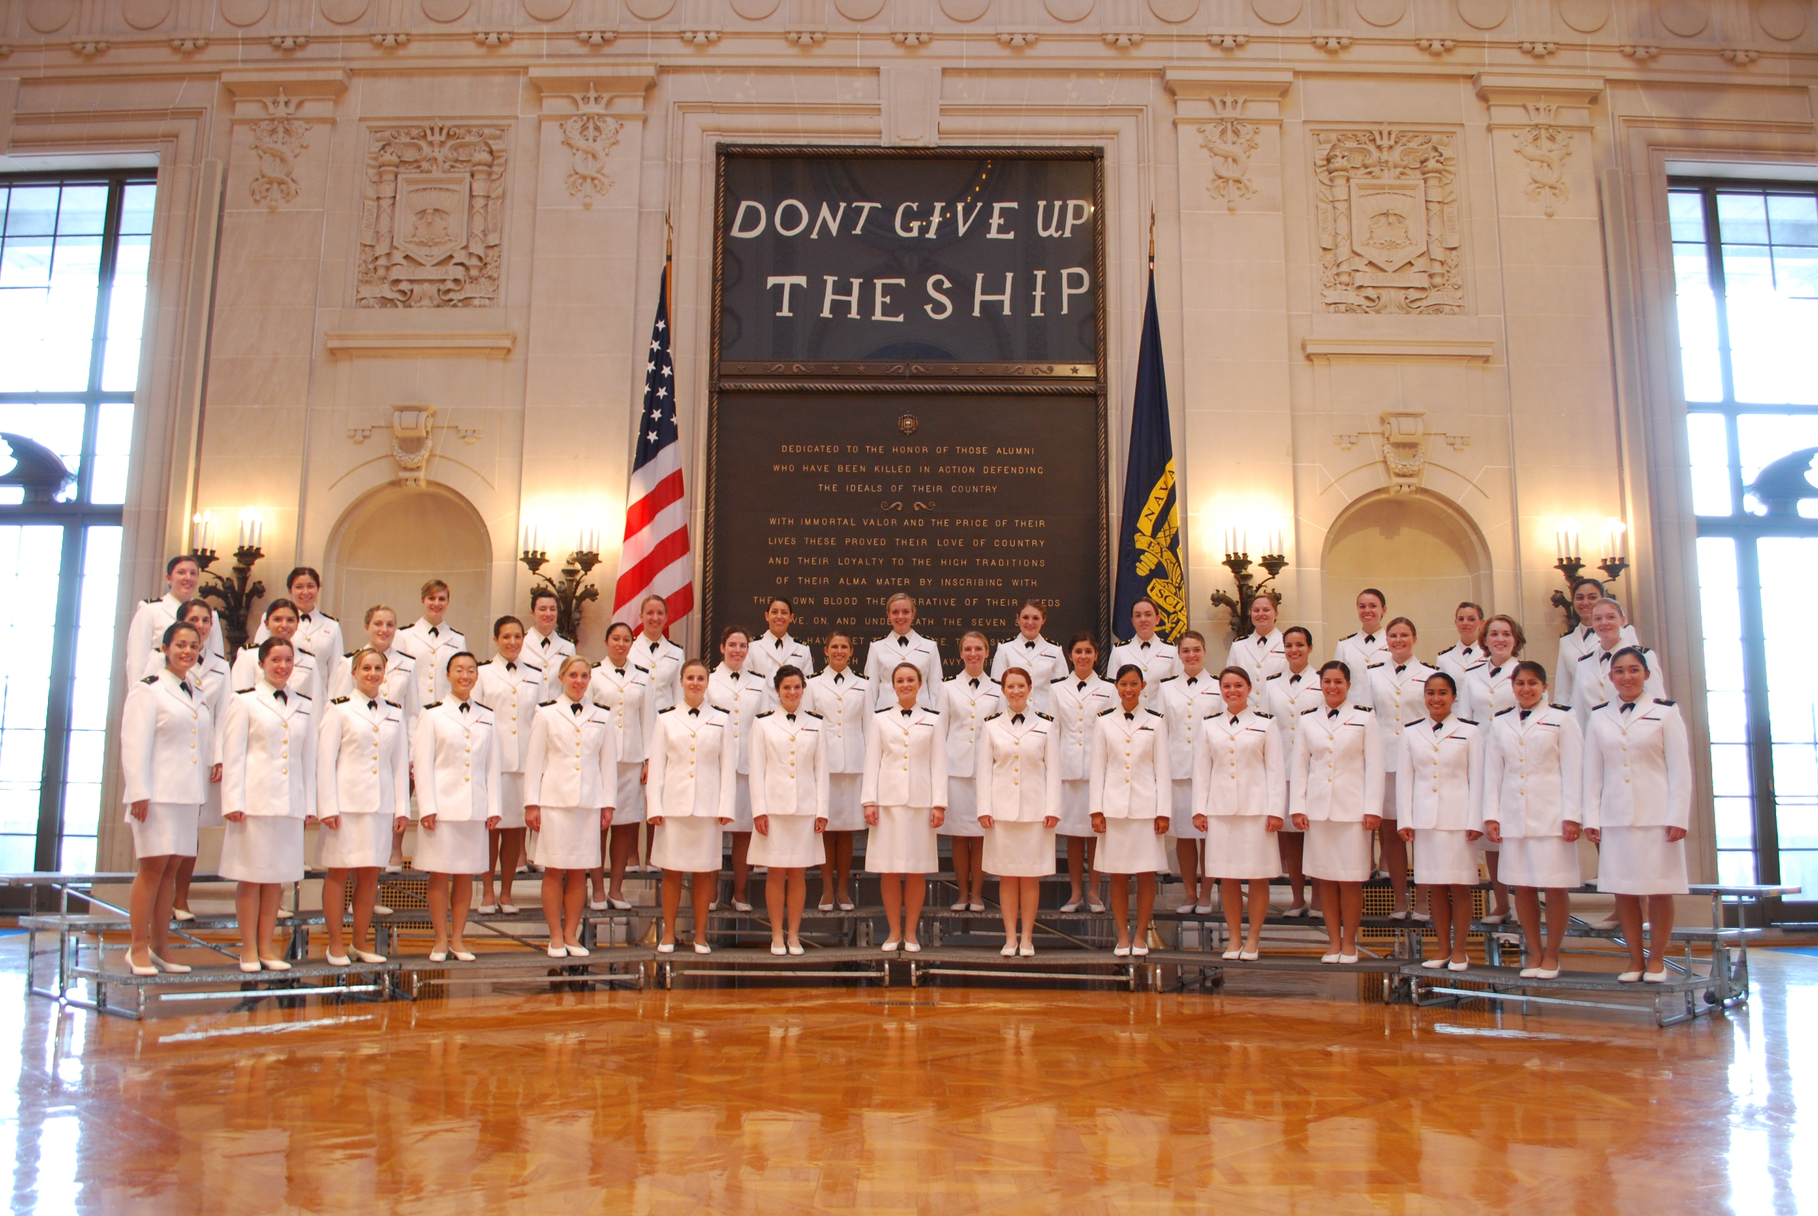
1976 - Service Academies open to women
Emily Perez, 1983- - 2006
“BRING ME MEN”
USNA Women’s Glee Club

Slide 18
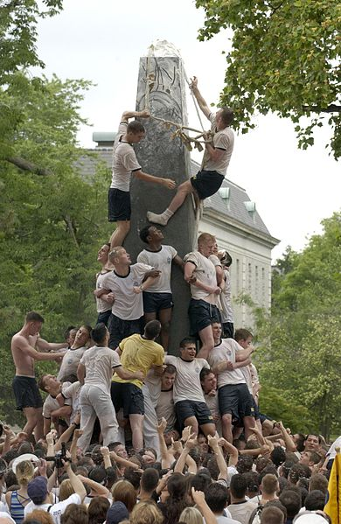
Herndon Monument

Slide 19
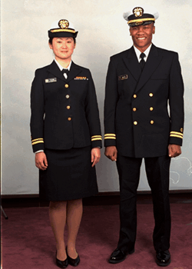
WUBA, Working Uniform Blue Alpha

Slide 20
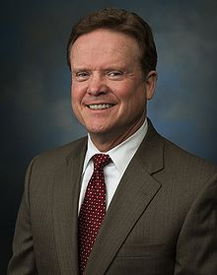
James Webb, former Sec. Navy and U.S. Senator

Slide 21
Reactions to Webb
- Supporters argue that women at the Service Academies were “feminizing” the Pentagon, that their very presence was corrosive to the essential esprit de corps or male bonding necessary for forging warrior leaders.
- Critics called his stress-is-fungible thesis simply wrong.
- Still others staged their own protest.

Slide 22
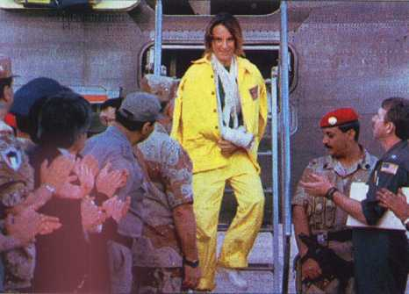
33,000 were deployed in Desert Storm (13 were killed and 2 taken POW)

Slide 23
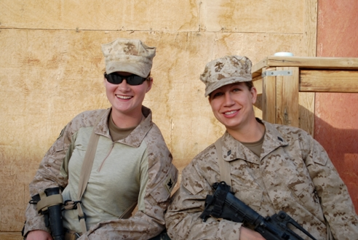
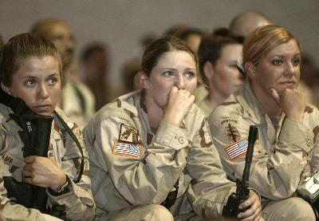
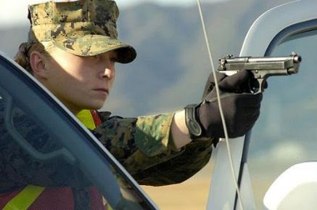
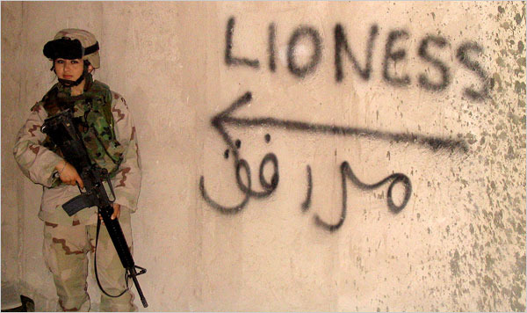
More than 212,000 women deployed in current wars

Slide 24
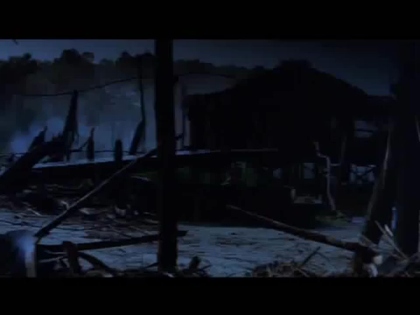
Women in Combat
G.I. Jane (1997) starring Demi Moore and Viggo Mortensen, directed by Ridley Scott

Slide 25
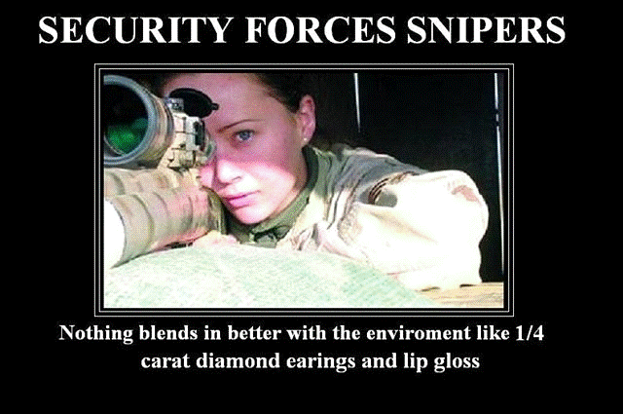
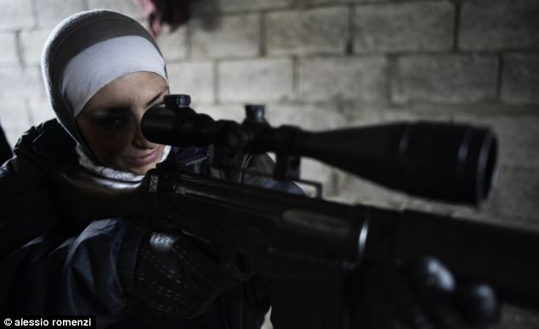
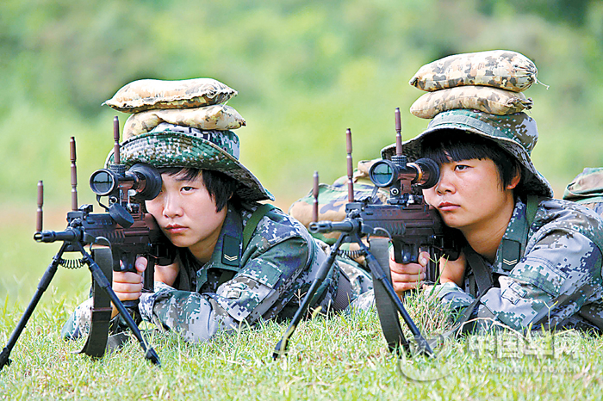
Military Snipers
Comments by Army Guard Sgt 1st Class Ben Dolan, former Marine sniper and the sniper school’s chief instructor:
“Frankly, women are better suited mentally for this job than most men….Women can shoot better, by and large, and they’re easier to train because they don’t have the inflated egos that a lot of men bring to these program…Women will ask for help if they need it, and they will tell you what they think”
http://userpages/aug.com/captbarb/sniper.html

